Slide 1
CA SharePoint Online Basics Webinar
GIS Collaboration Team Team–GIS–Collaboration@ca.com
March 2018

Slide 2
Maria Espino
Who am I?
Subject Matter Expert (SME) for SharePoint, circa 2000
Microsoft Certified Trainer (MCT), SharePoint 2010 & up.
Solutions Architect & Team Manager, over 120 Projects
Information Architect & UX Advocate
Principal Business Systems Analyst, CA circa 2014
Quarterback for the Production Support Team for SharePoint and Confluence Wiki
Principal, Business Systems Analyst | GIS Business Solutions Group GIS Collaboration Team location. Scottsdale, AZ office. 1.631.342.3245 | ext. 73245| maria.espino@ca.com

Slide 3
Our Helpful Moderators Today
We’ll Let Them Introduce Themselves…
Benjamin Weeks
Sr Platform Administrator | GIS Business Solutions Group GIS Collaboration Team location. Islandia, NY office. 1.631.342.5411 | ext. 75411 benjamin.weeks@ca.com
Dana Prey
Principal, Web Content | Product Development RND & MF/Product Development Business Lead E3 Program Chair, SharePoint/Wiki Governance Team location. Framingham, MA office. 1.508.628.8029 | ext. 88029 dana.prey@ca.com

Slide 4
What We’re Covering Today
What is SharePoint?
Site Collections
Navigational Elements
Site Components
Working with Sites
Simple Permissions
Easy Office Integrations

Slide 5
What We’re NOT Covering Today
Workflows for document libraries
custom workflows using SharePoint designer
Using design manager with publishing pages
in depth look at site owner actions
business analytics with SharePoint and power BI
custom excel dashboards based on SharePoint data
= Future Webinar Planned = Future Learning Class in LMS Planned
Our LMS courses are being designed and should be available soon. Visit the LMS portal at: https://learn.ca.com Keyword search term: SharePoint

Slide 6
What Is SharePoint?
1

Slide 7
What Is SharePoint?
SharePoint is a web-based, collaborative platform that integrates with Microsoft Office. Launched in 2001, SharePoint is primarily sold as a document management and storage system, but the product is highly configurable and usage varies substantially between organizations.

Slide 8
The Five Pillars of SharePoint
Organize. Discover. Manage. Build. Share.
Organize SharePoint allows you the ability to organize your documents in a way that suits your team and/or project.
Discover SharePoint incorporates a power multi-faceted search engine that gets you answers, insights, and connections.
Manage As a SaaS hosted environment, SharePoint provides a robust infrastructure that allows the company to scale easily and cost-effectively.
Build Create pages, apps, and new web experiences using familiar tools and corporate standards that integrate with Microsoft Office Suite of products on Office365.
Share SharePoint allows you to share your content in a secure manner with colleagues and customers.

Slide 9
Q & A
POST QUESTIONS IN THE SKYPE CONVERSATION WINDOW FOR OUR MODERATORS.

Slide 10
Site Collections
2
WHAT THEY ARE AND WHAT THEY DO

Slide 11
What Are Site Collections?
Collection of multiple sites that are logically grouped.
Usually grouped by department or type of sites.
Has an assigned business lead team to help our employees with simple requests.
These can be /teams/department (for collaboration sites)
Or they can be /sites/department (for publishing sites)
Figure 2.1 - Site Collections Explained

Slide 12
Fluidity in Architecture
The ability to move team sites from one area to another, or perhaps from one department to another, makes SharePoint Online one of the most fluid site architectures of all intranet products.
Figure 2.2 – Being able to start with a collaborative team site that can be then moved into a publishing site gives it great flexibility.

Slide 13
Departmental Site Collections
Publishing Sites
Department Portals
News, Links to Tools, Announcements
Informative Push Content
Department Contacts
Site Collection Admins
Uses the /sites/ URL Path
Collaboration Sites
Team Sites for Collaboration
Document Repository
Project Documentation
Push and Pull Content
Site Owners
Uses the /teams/ URL Path
Table 2.1 – Differences between /sites and /teams for every department.

Slide 14
Site Collection Administrators
GIS Collaboration (COLLAB-L2)
Tenant Administrators
Break-fix Errors
Workflows
Code Reviews for Advanced Design
Enhancements and Features
Advanced Expert Knowledge
Departmental Business Leads
Site Collection Administrators
Simple Access Requests
Help with Site Setup
Help with Site Usage
Basic Graphics and Page Setup
General Knowledge
Table 2.2 – Who helps to manage the Site Collections.

Slide 15
Creating Enhancements
Business Analysts
Product Owner
Capture Requirements
Write the User Story
Review with the Business Lead
Handle User Acceptance Testing
Works with Business Partners to Prioritize Enhancements
Handles Formal Communications
Set up Discovery Meetings to Review Need
Ensures Project Delivery
Interfaces with Developers to Push Story Forward
Has Ultimate Go/No Go Decision
Figure 2.3 – CA Agile Central User Story sample also available in PDF format.

Slide 16
Q & A
POST QUESTIONS IN THE SKYPE CONVERSATION WINDOW FOR OUR MODERATORS.

Slide 17
Navigational Elements
3
HOW TO GET AROUND OUR INTRANET

Slide 18
Tour of Our Global Navigation
Global navigation is a top level navigation bar that appears on all pages. It is a thin banner across the top of the pages of every site within a site collection, providing links to other parts of the SharePoint Online intranet. It also has options for the Office Suite and Settings (both Personal Settings and Site Settings for site owners).
Global Navigation
Office Suite Tiles
Ribbon Options
User Settings
Site Options
Search Options
Figure 3.1 – Our Global Navigation Explained

Slide 19
Mobile View Navigation
In mobile devices, we have a responsive menu.
In smaller screens even, the responsive menu activates.
Click anywhere on the menu to open the submenus.
Easy access on touch screens.
Hamburger Menu
Sub Menu
Figure 3.2 – Mobile View Global Navigation

Slide 20
Site Navigation
Sometimes hidden.
Should list site owners with “Click to email” feature.
Should have link to Site Contents.
Every site can be different.
Managed in two ways:
By Navigation Settings
By Document and List Settings
Figure 3.3 – Site Navigation Explained

Slide 21
Document Library Navigation
Not noticeable to users.
Hidden gem!
Folders are “no bueno”.
Figure 3.4 – Navigating document libraries, a little known secret.

Slide 22
Search vs. Navigate
Navigation is best for…
Getting to the news section
Getting to the help sites
Getting to the resources areas
Getting to departmental portals
Getting to other Office products via the Office Suite Tile
Search is best for…
Finding information when you don’t know where it might be
Finding information across the organization
Finding People across the organization
Searching across multiple platforms.
Table 3.1 – When to Use Search, When to Use Navigation

Slide 23
DEMO

Slide 24
Site Components
4
THE ANATOMY OF A SHAREPOINT SITE

Slide 25
Team Sites
8 of 10 sites are traditional team sites.
All sites have the same structure.
Page layouts will look different.
You can change the page layouts to suit your projects and teams.
Easy to add apps in Site Contents.
Left Menu
Site Ribbon
Page Layout
Site Options
Figure 4.1 – A traditional team site.

Slide 26
Site Options
Allows you to edit the home page.
Allows you to add new pages for new topics within your team or project.
Allows you to add a new app (library or list or other).
Accesses Site Contents
Accesses Site Settings (Site Owners)
Figure 4.2 – Site Options from the cogwheel.

Slide 27
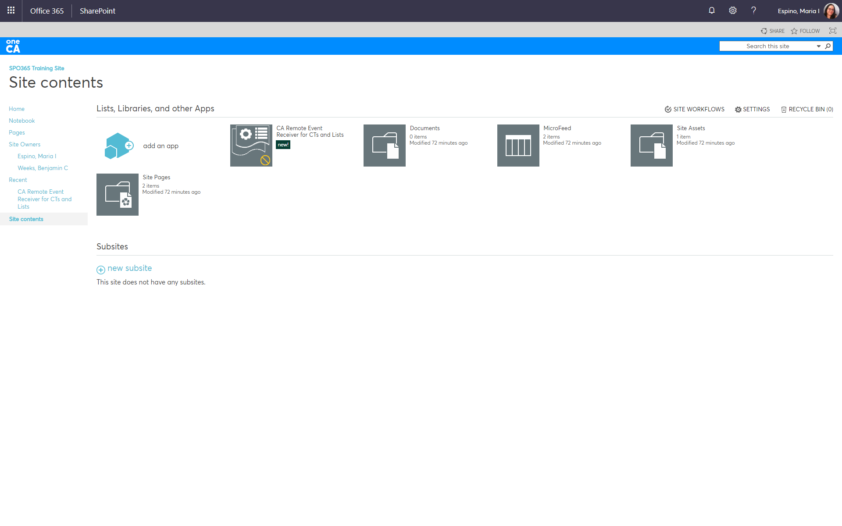
Site Contents
Add libraries or lists from Site Contents.
Request new sites.
Site owners can access settings, workflows, and recycle bins.
Add Apps
Subsites
Libraries and Lists
Site Workflows, Settings, & Recycle Bin
Figure 4.3 – Site Contents Page

Slide 28
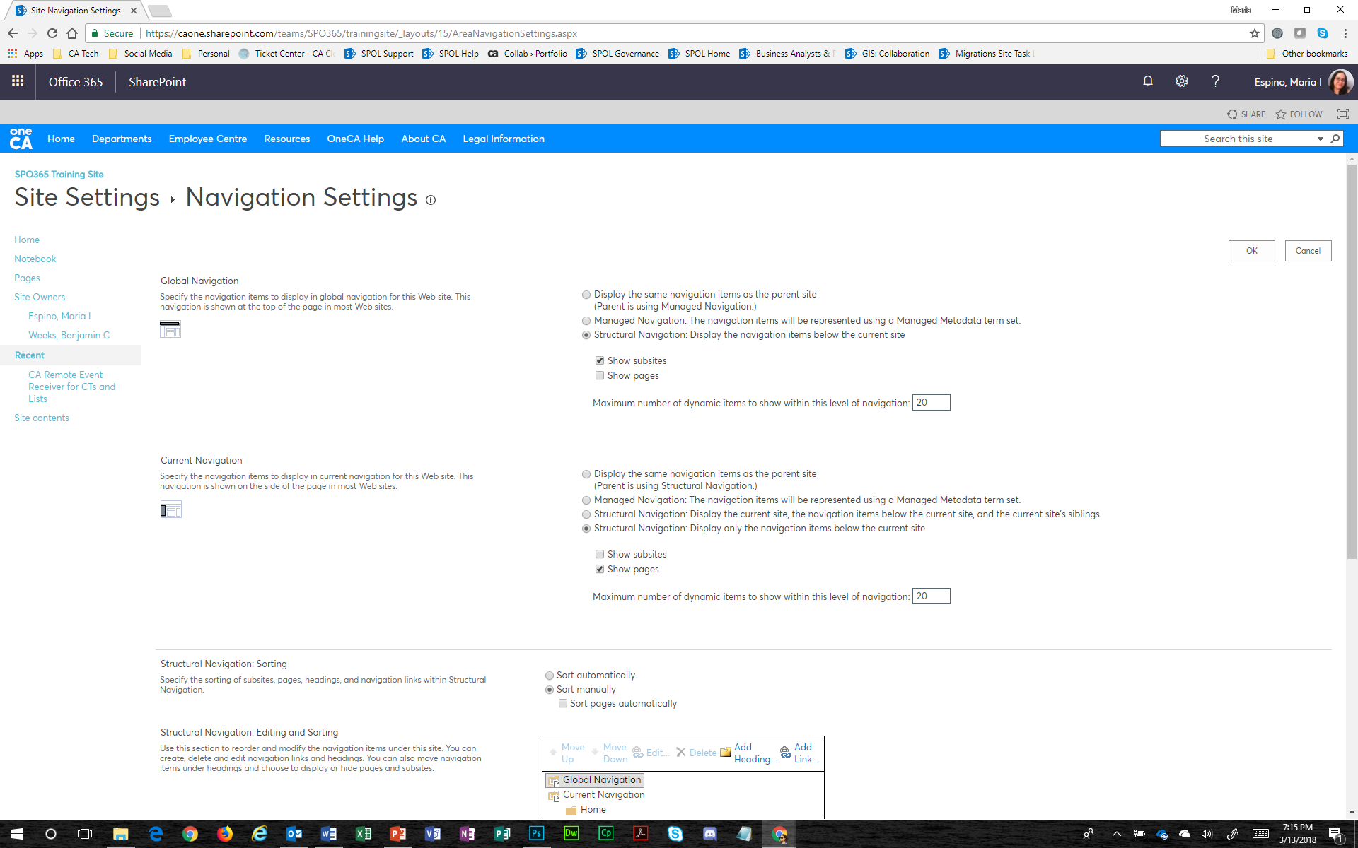
Left Menu
Site owners can change the settings for left hand menu.
At easy reach of all users.
Links to libraries and lists.
Lists the site owners for contact purposes.
Sometimes has a OneNote Notebook.
Figure 4.4 – Changing the navigation settings.

Slide 29
Site Ribbon
Very similar to Office Word, Excel, or PowerPoint.
Not used as often.
More options for integration.
Format Text Ribbon
Library Ribbon
List Ribbon
Figure 4.5 – Site ribbons are familiar but go largely unused.

Slide 30
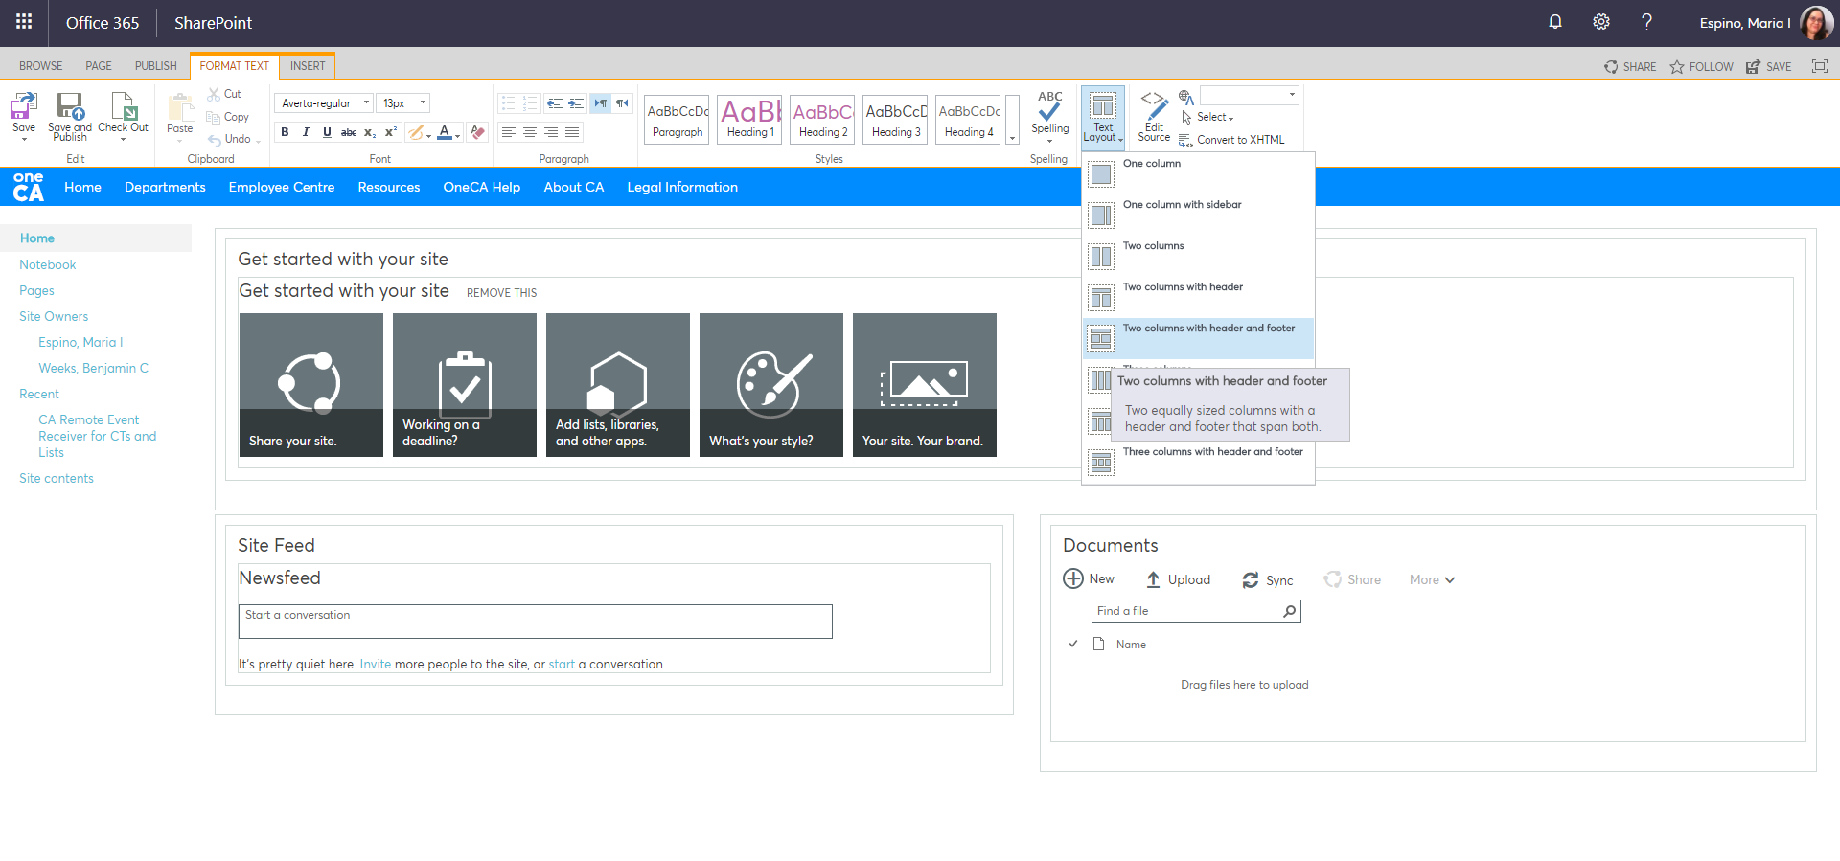
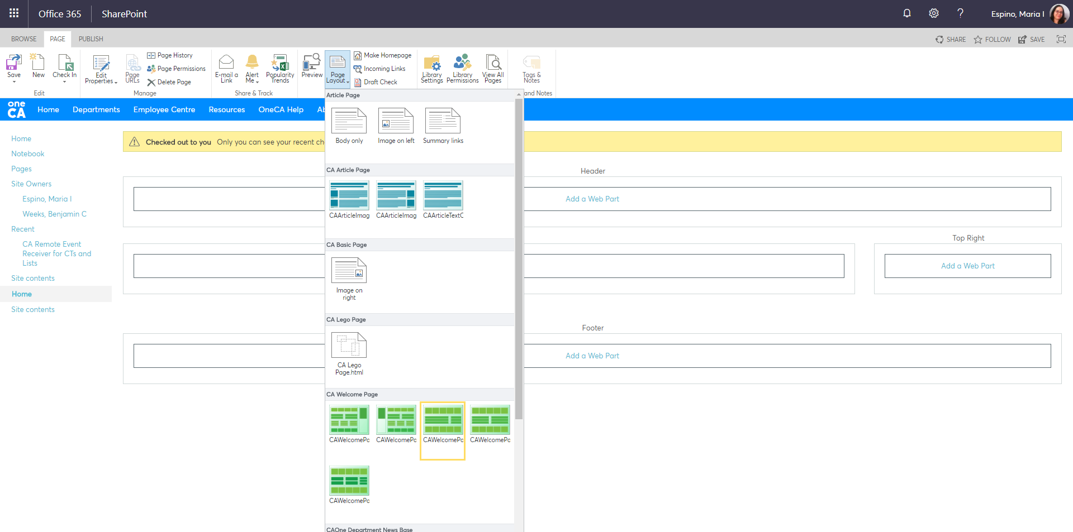
Page Layout
Various Page or Text Layouts on Pages.
Can surface apps on the pages from the Page ribbons.
Figure 4.6 – Layout variations on pages.

Slide 31
Q & A
POST QUESTIONS IN THE SKYPE CONVERSATION WINDOW FOR OUR MODERATORS.

Slide 32
BREAK TIME ☺
15 MINUTE BREAK FOR COFFEE, BATHROOM, TOUCHBASE.

Slide 33
Working with Sites
5
GETTING THE BEST OUT OF YOUR SHAREPOINT SITE

Slide 34
Requesting a Site
Requests are handled by our Business Leads for each department.
Requests are processed within 48 hours.
If you have not received a confirmation email from the business lead, you can contact them directly.
Governance is key to a healthy environment.
Figure 5.1 – Site Creation System – Quick Create Form

Slide 35
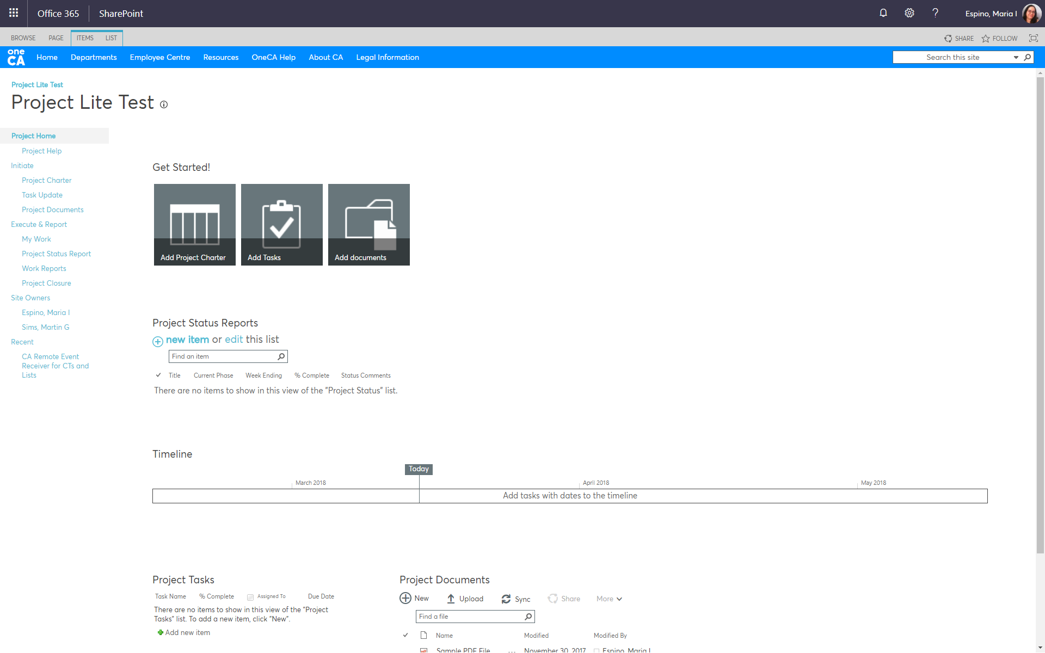
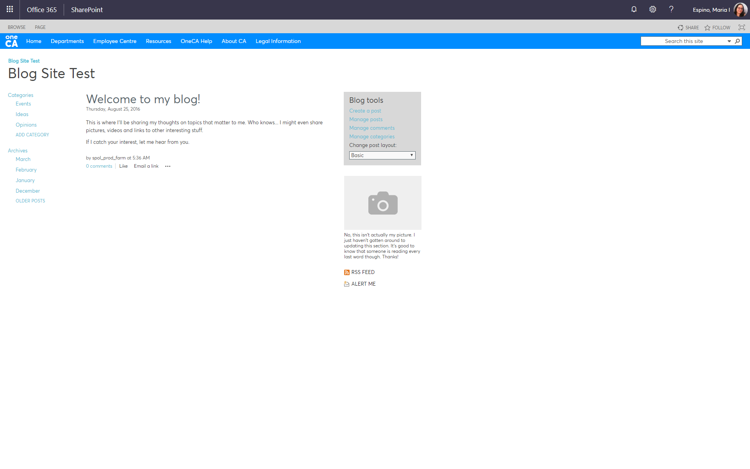
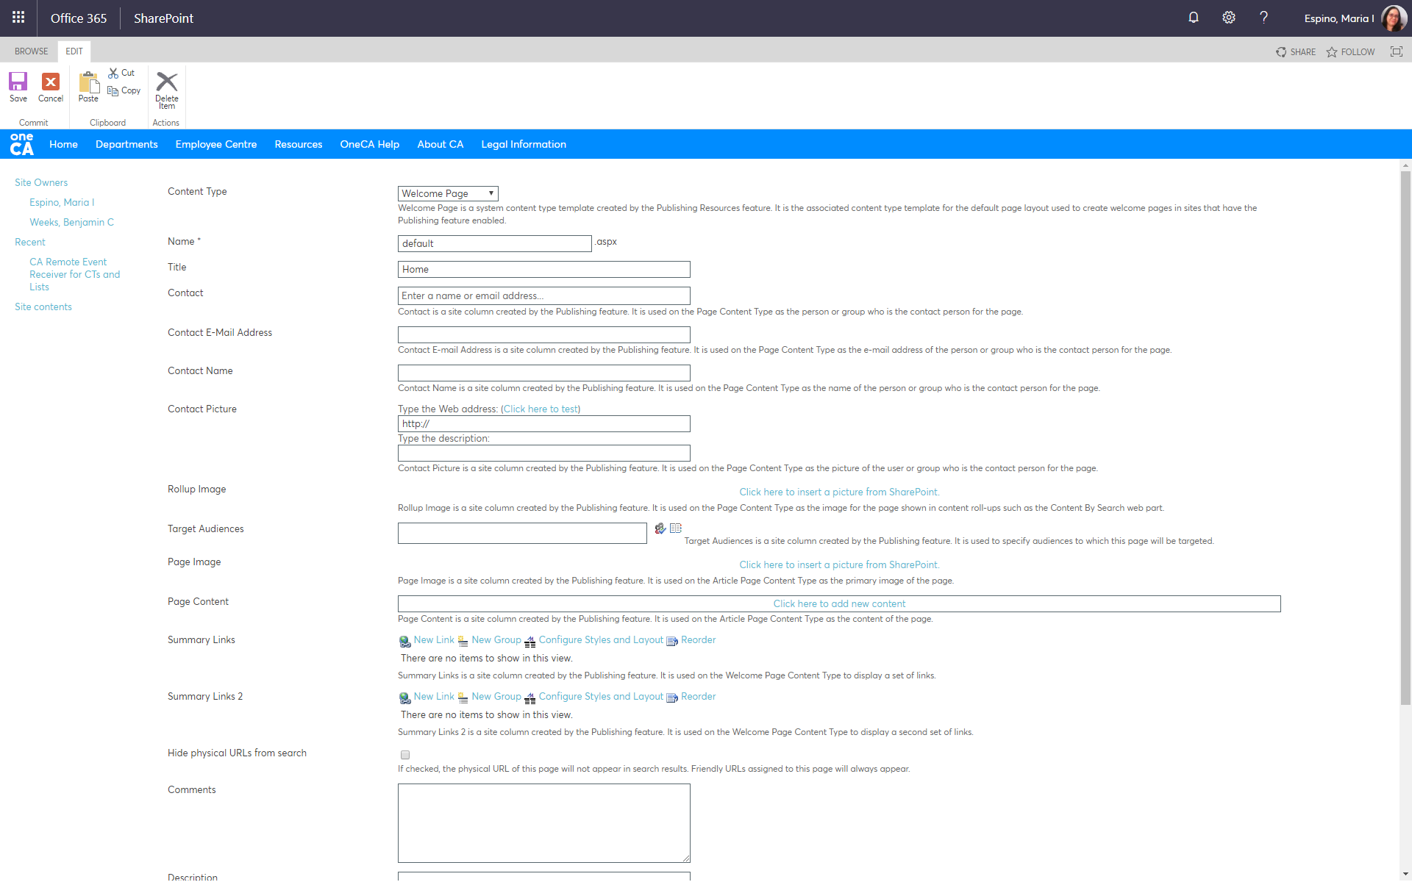
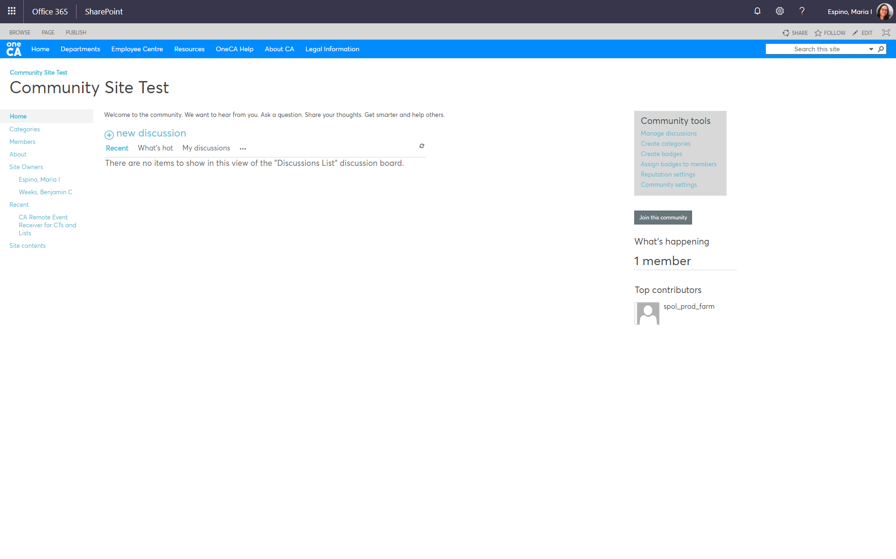
Site Templates
Allow for pre-structured sites that help coordinate teams based on function.
Several templates are available at the Site Creation process.
Some templates can be developed as part of our enhancement delivery.
Figure 5.2 – Various Site Templates are available for use.

Slide 36
Creating Apps
Microsoft now calls libraries and lists “apps”.
Creating apps is done by site owners or anyone with edit (not contribute) access.
Collaboration @ CA delivers custom apps for our colleagues that are popular high demand features not available out of the box.
To submit an idea for an app, open a Service Desk Ticket. We will review and prioritize based on our team’s resource capabilities.
Figure 5.3 – Libraries and Lists are known as “apps”.

Slide 37
Setting Up a Library
Can keep up to 500 versions of a document; but is that needed?
Can use folders, but we run into problems with folders. There is a better way!
Can have private libraries in public sites with breaking inherited permissions.
Can set up alerts for edits, synch a local folder, and also connect to Outlook!
Figure 5.4 – Setting up a new library.

Slide 38
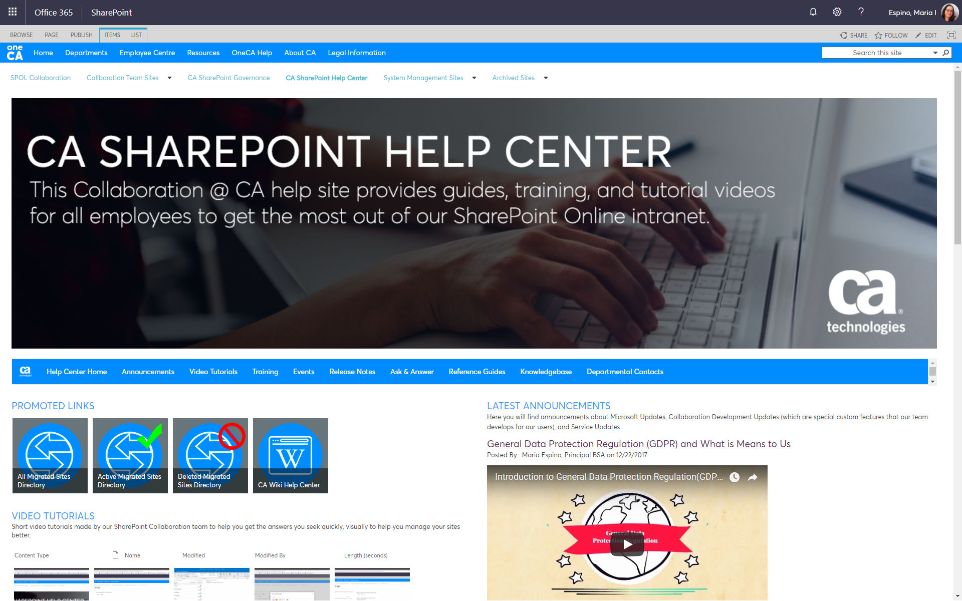
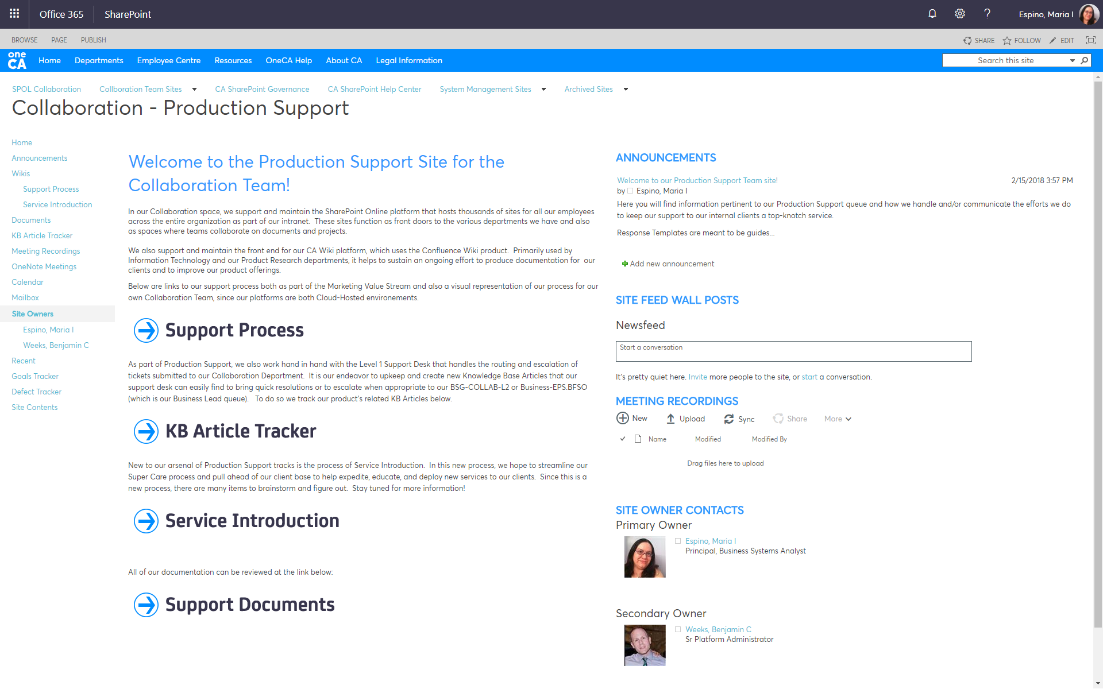
Creating a Home Page
Often not utilized to their full potential.
Whether you need a presentation site or a functional team site, home pages can make that happen for you.
Simple out of the box functionality.
Use the Page Ribbons! Lots of hidden options.
Figure 5.5 – The CA SharePoint Help Center site and the Collaboration Production Support Site, all done with OOTB functionality.

Slide 39
Q & A
POST QUESTIONS IN THE SKYPE CONVERSATION WINDOW FOR OUR MODERATORS.

Slide 40
Simple Permissions
6
ENSURE EASE OF USE FOR THE RIGHT TEAM MEMBERS

Slide 41
Permission Basics
Three Main Levels Come Standard
Visitors
Read Only
Limited Site Options
Not Shareable
Not able to contribute
Won’t be able to add to lists
Members
Contribute Access
Can upload, delete, add to libraries & lists
Can’t create new apps
Shareable
Somewhat Limited Site Options
Contribute vs. Edit
Owners
Full Access
Full Site Options
Configuration Rights
Can add pages
Can add apps
Can design pages
Shareable
Table 6.1 – Standard Permissions Review

Slide 42
Breaking Permission Inheritance
If you want your home page to be public, accessible to all employees, but want some private libraries or lists.
If you want to have a subset of employees to have more rights to an app than usual.
Breaking permissions isn’t permanent; permission inheritance can be re-established. Those “oops” moments.
Figure 6.1 – Breaking the site’s permission inheritance allows for more privacy for your project or team.

Slide 43
Library & List Permissions
Sites can be public, but have private libraries and vice versa.
Must break inheritance to have different permissions for lists/libraries.
Must have access to library/list settings or ask a site owner.
Reach out to Business Leads.
Figure 6.2 – Library or List settings is where you can set permissions.

Slide 44
Sharing in SharePoint
Sharing makes it easy to allow colleagues access to files quickly and easily.
Sharing has some quirks and you have to be mindful of secured documents.
Easier to get a link than to “share”.
Get Item URL feature from Collaboration @ CA
Figure 6.3 – How do I share my stuff in SharePoint?

Slide 45
Q & A
POST QUESTIONS IN THE SKYPE CONVERSATION WINDOW FOR OUR MODERATORS.

Slide 46
Easy Office Integrations
7
WORK WITH OFFICE 365 PRODUCTS DIRECTLY FROM SHAREPOINT

Slide 47
Office Online vs. Desktop Client
Office Online
Auto saves your changes.
Easy notation and comments.
Has co-authoring fully available with comment integration.
Has limited options available via the ribbon.
Macro-enabled content is very limited, often not able to be displayed.
Desktop Client
Can have auto save set up, but not on by default. Requires manual save.
Has co-authoring available in limited ways.
Has all the available options via the ribbon.
Macro-enabled content is fully available.
Table 7.1 – The differences between the browser-versions of Office and the desktop version of Office.

Slide 48
Working with OneDrive
Syncing Libraries and the Differences Between SP vs. OD
Sync
One way synchronizations.
Cannot delete items.
Cannot manage permissions from a Sync Folder.
Connection dependent, doesn’t always work outside of company access.
Differences
OneDrive is a cloud-based “file share”.
OneDrive uses SharePoint UI but isn’t same as SharePoint.
OneDrive is for personal files; like a cloud-based hard drive so its tied to your PMF account.
SharePoint is for team collaboration.
Best Practices
Store personal files in OneDrive.
Store team files in SharePoint.
Do not overly share your OneDrive folders; use SharePoint libraries instead.
OneDrive is supported by Office 365 Team, not the Collaboration Team.

Slide 49
Working with Outlook
Connecting Lists, Libraries, and Calendars from SharePoint
Lists
Can connect list items to an Outlook folder for easy access.
Instant notification of changes.
Double click opens the list item from SharePoint itself.
Libraries
Can also connect libraries to an Outlook folder for easy access.
Instant notification of changes.
Double click opens the document from SharePoint itself.
Calendars
Can also connect a SharePoint Calendar to Outlook.
Meeting invites can be sent from the calendar but accept/declines are not tracked.
Can copy events on a SharePoint Calendar to your local calendar by drag and drop.

Slide 50
Working with Excel Sheets
Creating Lists from Excel, Exporting Lists to Excel, Data Sheet Views
Create Lists
Import an Excel list into SharePoint for better access and collaboration.
Upload as Excel Sheet.
Export Lists
Export a list into Excel and keep the data fresh and up to date with the Data Refresh feature.
Create dashboards from in Excel from list data. With data refresh, this becomes a powerful tool.
Great Excel Ribbon options.
Datasheet Views
View a list in “datasheet” format for easy addition.
Copy and paste from Excel and tables.
Slice and dice the data with custom views.

Slide 51
Working with OneNote
The Best Way to Take Meeting Notes
Why OneNote?
Team collaboration made easy with co-authoring of meeting participants.
Easy integration with Outlook for sending meeting notes to participants.
Easy access via SharePoint Notebook on your SharePoint site.
Open multiple notebooks in desktop client.
Create meeting note templates that suit your style.
Table 7.2 – OneNote, the magical note-taker.

Slide 52
Q & A
POST QUESTIONS IN THE SKYPE CONVERSATION WINDOW FOR OUR MODERATORS.

Slide 53
Test Your Knowledge
Global Navigation
Use Search
Navigate
Working With Documents
Working with Calendars
Work
Use Library Sync Options
Connect to Outlook
Integrate
This simple quiz will let you test how much you’ve absorbed from today’s topics.
It’s optional, however if you score a passing grade of 80% or better we will email you a completion certificate with your name on it.
Any questions or concerns, please email us at team-gis-collaboration@ca.com

Slide 54
Complete the Survey
Teach
Analyze
Capture
Surveys help us gauge how we should structure more webinars and training courses in the future. They are invaluable tools for our company and provide you a chance to be heard as to what you want to learn from us. We thank you for your participation.

Slide 55
Thank You.

Slide 56
Maria Espino
Principal BSA, GIS Collaboration Team Solutions Architect, Certified Trainer
Maria.Espino@ca.com
@cainc
GIS Collaboration Team
http://linkedin.com/MariaEspino
https://onecahelp.ca.com

